Slide 1

Christmas
At the Chapel of the Opened Book
Graham Thomason

Slide 2
Christ-mas = Messiah-mas
It is about a person
χρίω = chrīō = to anoint.
Χριστός = Christos = Anointed (One).
מָשַׁח = māshach = to anoint, baste (Ex 29:2)
מָשִׁיחַ = māshiach = messiah
Kings are anointed – messiahs – in the Old Testament.
But there is one par excellence.

Slide 3
Some Christmas Card Favourite Verses
Isaiah 9:6 (Alluded to in Lk 2:11.)
  For a child is to be born for us,
  A son is to be given to us,
  And he will shoulder government,
  And he will be called Wonderful, Counsellor,
  Mighty God, Father of Perpetuity,
  Prince of Peace.

Slide 4
1 John 4:9, 1 John 4:14b
This is how the love of God was made manifest among us: in that God has sent his only-begotten son into the world in order that we should live through him.
The father has sent the son as the saviour of the world.

Slide 5
Luke 2:11
For today a saviour, who is Christ the Lord, was born to you in the city of David.

Slide 6
Luke 2:14 – A Textual Issue
Luke 2:14 FAA | Δόξα ἐν ὑψίστοις θεῷ, καὶ ἐπὶ γῆς εἰρήνη· ἐν ἀνθρώποις εὐδοκία. | “Glory in the highest realms to God, And peace on earth; Goodwill among men.”
B^{c} א^{c} 𝔐 (about 2000) K L M P U Γ Δ Θ Λ Ψ f¹ f¹³ 2 28 157 (Swanson). All Scrivener’s 27 manuscripts.
Dean John Burgon (Revision Revised p. 43) adds 29 early (2nd – 7th century) church fathers
Luke 2:14 NIV | Δόξα ἐν ὑψίστοις θεῷ, καὶ ἐπὶ γῆς εἰρήνη· ἐν ἀνθρώποις εὐδοκίας. | “Glory to God in the highest heaven, And on earth peace To those on whom his favour rests.”
B* א* A D W (Swanson). NA²⁸ gives 2 church fathers. This reading is in W&H and the R.V. etc.
Burgon (Revision Revised p. 41) explains how the ἐν dropped out, then to make better Greek the sigma was added at the end. N.B. When I look at the scans of at B (03) and א (01), I don’t see any trace of an old sigma. But Burgon accepted B* א* A D. I can show the issue later with recording off.

Slide 7
Wikipedia, Brooke Foss Westcott
History of the page, as edited on 26 September 2015, at 19:44 (UTC).
Since controversy was "un-Christian," he refused to answer John Burgon's arguments concerning the Local Text of Alexandria which Westcott helped exalt. He simply said, "I cannot read Mr. Burgon yet. …“
https://en.wikipedia.org/w/index.php?title=Brooke_Foss_Westcott&oldid=682889761
Let’s just go back to the true text.
  “Glory in the highest realms to God,
  And peace on earth;
  Goodwill among men.”

Slide 8
BTW, Some places to get Christian Cards
https://gospelcardsetc.com/
https://www.barnabasaid.org/gb/resources/christmas-cards/
https://justcardsdirect.com/
https://www.dayone.co.uk/collections/cards-and-gifts/christmas-card

Slide 9
What we will look at
Christ in the O.T. & Christ in the N.T.
The first announcement
In prophecy
  How will the Messiah come?
  When will the Messiah come?
  Where will he come?
  What will his lineage be?
As history, fulfilment
  How did the Messiah come?
  When did the Messiah come?
  Where did he come?
  What was his lineage?

Slide 10
Promises of the Messiah
The first announcement
Gen 3:14 -15
At this the Lord God said to the serpent, [Satan, the devil, Rev 20:2]
  “Because you have done this,
  You are more cursed than all the cattle
  And than all the wild animals.
  You will go on your belly
  And eat dust all the days of your life.
  And I will put enmity between you and the woman,
  And between your seed and her seed.
  It will crush your head,
  But you will crush it in the heel.”
Notes:
Chrio Mashiach Annoint

Slide 11
Seed of the Woman
In fallen mankind, both male and female carry the sinful nature.
But this sinful nature is transmitted to the next generation through the male, not the female. This is built into the Hebrew language.

Slide 12
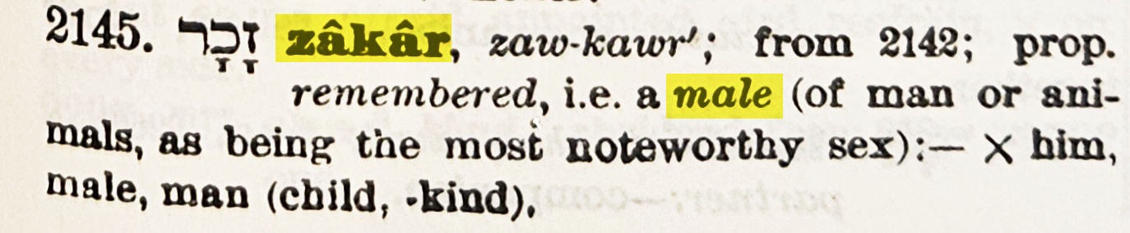
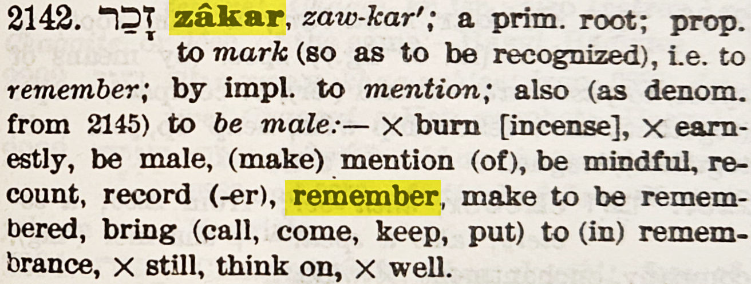
Male in Strong’s Concordance

Slide 13
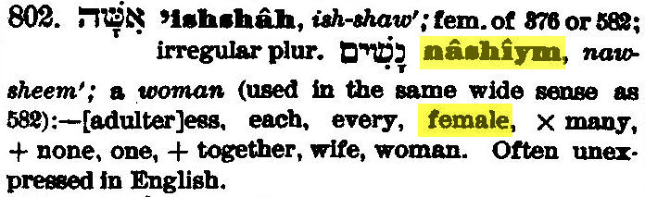
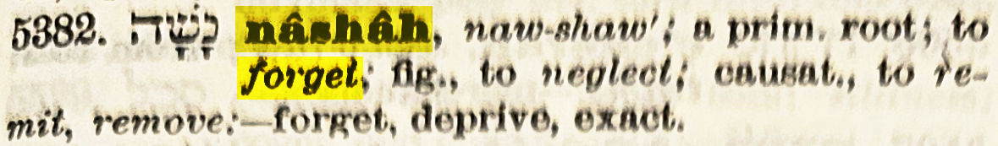
Female in Strong’s Concordance

Slide 14
How will the Messiah come?
Isa 7:14
Therefore the Lord* himself will give you a sign. Behold, a virgin will conceive and bear a son, and she will call him Immanuel.
עִמָּנוּ אֵל Immanu-El With-us is God

Slide 15
How did the Messiah Come?
Matthew 1:20
²⁰But after he had reflected on these things, what should happen but the angel of the Lord appeared to him in a dream and said, “Joseph, son of David, do not be afraid to take Mary to be your wife, for that which has been conceived in her is so by holy spirit. ²¹And she shall bear a son, and you will call him Jesus, for he will save his people from their sins.” ²²Now all this took place in order that that which was spoken by the Lord through the prophet should be fulfilled, where he says, ²³“Behold, a virgin will be with child and will bear a son, and they will call him Emmanuel, which when translated is ‘God with us.’ ”

Slide 16
(The Lord) Jesus
Hebrew יֵשׁוּעִ, Yeshua, a contracted form of יְהוֹשׁוּעַ Yehoshua, AV Joshua, Yahweh/Jehovah saves.
From Hebrew root ישׁע, yasha = to save ( in hiphil, הוֹשִׁיעַ), the same root as in Hosanna. N.B. יְשׁוּעָה, Yeshuah, = salvation.
Acts 4:8-12 ⁸Then Peter, filled with holy spirit, said to them, “Rulers of the people and elders of Israel, ⁹if we today are being examined about the good work on a sick man, by what means he has been cured, ¹⁰let it be known to all of you and to all the people of Israel that it is in the name of Jesus Christ the Nazarene, whom you crucified, whom God has raised from the dead – that it is by him – that this man stands here in your presence, healthy. ¹¹He is The stone which was rejected by you builders, But which has become the keystone. ¹²And there is no salvation in any other, for neither is there any other name given among men by which we must be saved.”

Slide 17
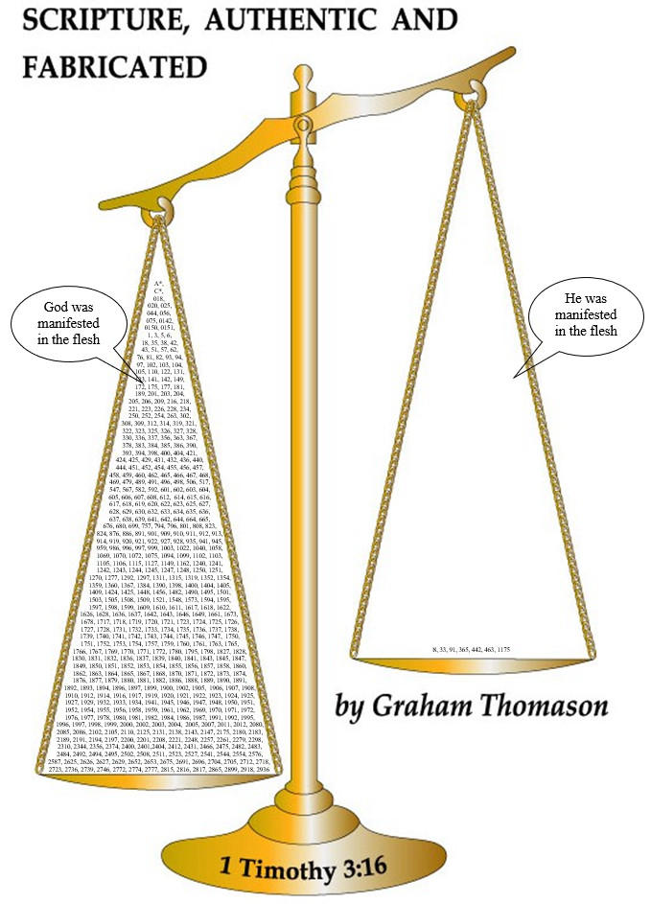
Immanuel –
God with Us
Not just a name
1 Tim 3:16
1 Tim 3:16
God was manifested in the flesh

Slide 18
Promises of the Messiah – When will He come?
Dan 9:24-27 (covers the “cutting off” – not the birth)
Seventy year-weeks have been determined concerning your people and concerning your holy city, to put an end to transgression and to seal up sins, and to atone for iniquity, and to bring in age-abiding righteousness, and to seal the vision and prophet, and to anoint the holy of holies.
And know and understand that from the issuing of the order to restore and rebuild Jerusalem up to messiah the leader, there are seven year-weeks and sixty-two year-weeks, and street and ditch will be built again, but in distressful times.
And after the sixty-two year-weeks, messiah will be cut off, but not for himself, and the people of the coming leader will spoil the city and the sanctuary, and his end will be with a flood. And until the end of the war, desolations are determined.
And he will confirm a covenant with many for one year-week, and after half of the year-week he will put a stop to sacrifice and meal-offering, and he who makes desolate will stand on the pinnacle of abominations, and this will be until the conclusion. Then what is determined will be poured out on the desolator.”
Notes:
26pt. 2pt more than recommended minimum. Green for the goody, red for the baddy, yellow for the numbers

Slide 19
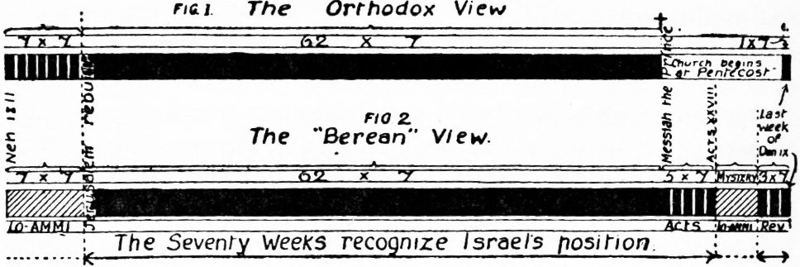
62 + 7 + 1 year-week
Alphabetical Analysis, Dispensational Truth, Vol. 4, p.252
The orthodox stop the prophetic clock, but in a wrongly divided way.
Com-mand-ment
454 BC.
⬇
Temple rebuilt
405 BC.
⬇
29 A.D.
⬇
63 A.D.
⬇
There are 7 year-weeks here, but are they part of the 70 (Israel = Ammi= My people)?
⬇
GGT: Prophetic clock stopped in hatched areas.
Notes:
The Alphabetical Analysis, **Part 4, R to S, p.252. SEVENTY WEEKS p. 248. Also Part 9 p. 219. SEVENTY WEEKS p. 209-223.

Slide 20
When did the Messiah come?
(Yes, he has come.) The short answer: on time.
Both the Orthodox view and the Berean View have the “cutting off” (crucifixion) at 29 AD. This was fulfilled.
As for the birth of the Messiah, we do not directly have the exact year from O.T. prophecy. We can state that Messiah came to the cross “on time”.
The Christian calendar isn’t a precise guide, and the birth may be 4 or 5 B.C. The Julian calendar (based on 1 leap year every 4 years started in 45 B.C, but it wasn’t aligned to the birth of Christ as an AD dating system until 525 AD (Wikipedia Anno Domini). This dating system was devised in 525 by Dionysius Exiguus but was not widely used until the 9th century. The Gregorian (current) calendar took over in the UK in 1752. It has a better system of leap-years. To correct an accumulated shifting of the spring equinox, the Julian calendar day Thursday, 4 October 1582 was followed by the first day of the Gregorian calendar, Friday, 15 October 1582.

Slide 21
When did the Messiah come?
Luke 3:23
  Now Jesus himself was about thirty years old, beginning his ministry,
If his ministry was for 3 years, then he was
  30 in 26 A.D. (30 from Luke 3:23, 26 A.D. a conjecture)
  33 in 29 A.D. when crucified (3 years later, a conjecture; 29 AD from Daniel)
  5 in 1 A.D. subtracting 28 from each number
  4 in 1 B.C. subtracting another 1 (No year 0!)
  0 in 5 B.C. subtracting another 4, taking us to his birth
So the Messiah would be born (0 years old) in 5 B.C.
On Christmas day!

Slide 22
When did the Messiah come?
Biblical versus non-Biblical sources*
Luke 2:1-2:7 Now it came to pass in those days that a decree went out from Caesar Augustus that the whole Roman world should be registered. ²This registration was the first to take place when Cyrenius (Quirinius) was governor of Syria. …
Wikipedia (Census_of_Quirinius) dates the census as 6 A.D., and criticizes the N.T. as being erroneous, and sees the census as a purely literary device … to associate Mary and Joseph.
Luke 2:2 itself strongly suggests that there was a second registration some time later. Quite possibly the academics only have a record of the second registration.
We are used to such attacks. We have already indicated the likelihood of two (or more) registrations.
The attacks also are challenged by many others, including John H. Rhoads [in JETS 54.1, March 2011 65–87], David Armitage (Tyndale House, Article, 21st December 2022).
* This sheet has been modified a little since the address in the Chapel of the Opened Book.
Notes:
JETS = Journal of the Evangelical Theological Society

Slide 23
Where will the Messiah come?
Micah 5:2
  “But as for you, Bethlehem Ephrathah,
  Although you are small among the thousands of Judah,
  From you he who is mine will come out,
  To be a ruler in Israel,
  Yet his goings are of age-old time.

Slide 24
Where did the Messiah come?
Luke 2:1-7
¹Now it came to pass in those days that a decree went out from Caesar Augustus that the whole Roman world should be registered. ²This registration was the first to take place when Cyrenius was governor of Syria. ³So everyone went to be registered – each one to his own town. ⁴And Joseph also went up from Galilee, from the town of Nazareth, to Judaea, to the city of David, which is called Bethlehem, because he was of the house and the paternal lineage of David, ⁵to have himself registered with Mary, the woman betrothed to him, who was expecting a child. ⁶And it came to pass when they were there, that the days for her to give birth became due, ⁷and she gave birth to her firstborn son, and she wrapped him in swaddling clothes, and she laid him in a feeding-trough, because there was no room for them in the inn.
This sheet has been modified a little since the address in the Chapel of the Opened Book.

Slide 25
Genealogy – The Lineage
The Messiah will come through Abraham
Gen 22:18
And all the nations of the earth will be blessed through your seed, because you have obeyed me.
Quoted in Acts 3:25, Gal 3:8.

Slide 26
The Messiah comes through Judah
Gen 49:10
The sceptre will not depart from Judah,
Nor the statute maker from between his legs,
Until Shiloh comes,
And obedience of the nations
Will be to him.

Slide 27
The Messiah comes through King David
Jer 23:5-6
⁵Behold, the days are coming,
Says the Lord,
When I will raise a righteous branch to David,
And he will reign as king,
And he will act wisely
And administer justice and righteousness in the land.
⁶In his days Judah will be saved,
And Israel will dwell securely,
And this is his name by which he will be called:
The Lord our Righteousness.

Slide 28
The Legal & Royal Genealogy – to Joseph
Matthew 1
1The book of the lineage of Jesus Christ, the son of David, the son of Abraham. ²Abraham begot Isaac, and Isaac begot Jacob, and Jacob begot Judah and his brothers, ³and Judah begot Perez and Zarah by Tamar, and Perez begot Hezron, and Hezron begot Ram, ⁴and Ram begot Amminadab, and Amminadab begot Nahshon, and Nahshon begot Salmon, ⁵and Salmon begot Boaz by Rahab, and Boaz begot Obed by Ruth, and Obed begot Jesse, ⁶and Jesse begot David the king, and David the king begot Solomon by Uriah's wife, ⁷and Solomon begot Rehoboam, and Rehoboam begot Abijah, and Abijah begot Asa, ⁸and Asa begot Jehoshaphat, and Jehoshaphat begot Jehoram, and Jehoram begot Uzziah, ⁹and Uzziah begot Jotham, and Jotham begot Ahaz, and Ahaz begot Hezekiah, ¹⁰and Hezekiah begot Manasseh, and Manasseh begot Amon, and Amon begot Josiah, ¹¹and Josiah begot Jeconiah and his brothers at the time of the Babylonian deportation. ¹²And after the Babylonian deportation, Jeconiah begot Shealtiel, and Shealtiel begot Zerubbabel, ¹³and Zerubbabel begot Abihud, and Abihud begot Eliakim, and Eliakim begot Azzur, ¹⁴and Azzur begot Zadok, and Zadok begot Jachin, and Jachin begot Elihud, ¹⁵and Elihud begot Eleazar, and Eleazar begot Mattan, and Mattan begot Jacob, ¹⁶and Jacob begot Joseph, the husband of Mary by whom Jesus was conceived, who is called Christ. ¹⁷So all the generations from Abraham to David amount to fourteen generations, and from David to the Babylonian deportation there are fourteen generations, and from the Babylonian deportation to Christ there are fourteen generations. ¹⁸But the begetting of Jesus Christ was as follows. Now then, when his mother Mary was betrothed to Joseph, before they came together, she was found to be with child, by holy spirit. ¹⁹But Joseph, her husband-to-be, being righteous, and not wishing to make an example of her, wanted to divorce her secretly. ²⁰But after he had reflected on these things, what should happen but the angel of the Lord appeared to him in a dream and said, “Joseph, son of David, do not be afraid to take Mary to be your wife, for that which has been conceived in her is so by holy spirit. ²¹And she shall bear a son, and you will call him Jesus, for he will save his people from their sins.”

Slide 29
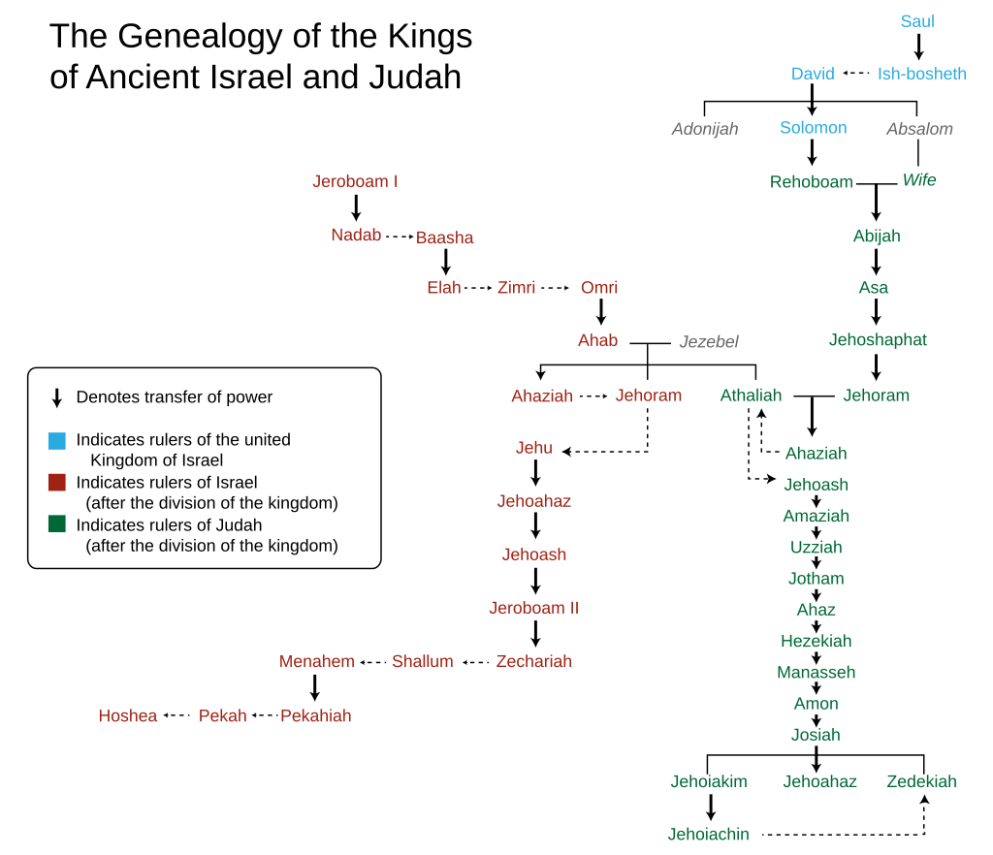
https://en.wikipedia.org/wiki/Kings_of_Israel_and_Judah#/media/File:Genealogy_of_the_kings_of_Israel_and_Judah.svg
2 Ki 24:6 And Jehoiakim lay with his fathers, and Jehoiachin his son reigned in his place.
1 Chr 3:16 And the sons of Jehoiakim were Jeconiah his son, and Zedekiah his son.
Jer 22:24 As I live, says the Lord, even if Coniah the son of Jehoiakim, the king of Judah, were a signet on my right hand, I would still pluck you off it. … ³⁰This is what the Lord says:
«Record this man as childless
– A man who will not prosper in his days –
For none of his seed will prosper,
Neither as a man sitting on the throne of David,
Nor a ruler in Judah any more.» ’ ”
Jehoachin = Jeconiah = Coniah
Notes:
NB same names: Jehoram (contemporary as well ), Jehoash (of Judah, also kept in temple). Jeroboam I II, Zechariah, Hoshea, Manasseh

Slide 30
The Genealogy of “Jesus” via Mary
Luke 3:23-3:38
²³Now Jesus himself was about thirty years old, beginning his ministry, being, as was reckoned by law, the son-in-law of Joseph, who was the son-in-law of Heli, ²⁴who was the son of Mattath, who was the son of Levi, who was the son of Melchi, who was the son of Janna, …

Slide 31
Luke 1:35, 3:23-3:38
God
son
Adam
Eve
Holy Spirit
Etc.
David
Bathsheba
Etc.
Mattath
wife
son
Heli
wife
son-in-law
Joseph
Mary
by law
son-in-law
ἐνομίζετο
(The Lord) Jesus

Slide 32
Two Genealogies?
Yes, like everyone’s, apart from consanguineous ones.
Matthew gives the royal line, Luke the physical descent.
Both are from King David. They are completely separate until they have a common ancestor at David.
Matthew’s Shealtiel, Zerubbabel and Luke’s Shealtiel, Zerubbabel are different people with the same name.
  Jeconiah begot Shealtiel, and Shealtiel begot Zerubbabel, (Matt 1:12)
  Zerubbabel, who was the son of Shealtiel, who was the son of Neri, (Luke 3:27)
  Jeconiah is not Neri. The Shealtiels have different fathers, grandfathers …
No need for abstruse explanations (Levitical yibbum יִבּוּם marriage)

Slide 33
Christmas is a time for giving
For God so loved the world, that he gave his only-begotten son, so that everyone who believes in him should not be lost, but have age-abiding life. John 3:16
… the son of God, who loved me and gave himself for me. Galatians 2:20
… for you have been saved by grace, through faith, and this is not of yourselves; it is the gift of God, Ephesians 2:8
Thanks be to God for his indescribable gift. 2 Corinthians 9:15
These verses are available as an insert to Christmas cards at
https://www.faraboveall.com/010_Tracts/01_Tracts.html

Slide 34
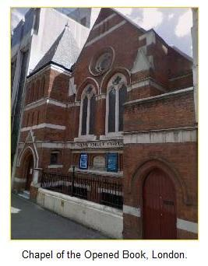


?
Notes:
Animations, Animation pane (2x) , Select picture, Pull down, effect options drum, chime, push

